Slide 1
Movie Rating Prediction with IMDb Dataset
Yipeng Han

Slide 2
Introduction
Goal:
Using data from IMDb source to build a model to predict the movie ratings
Notes:
Lesson descriptions should be brief.

Slide 3
Introduction
1. Describe Data
2. EDA and Assumption
3. Build Machine Learning Model
4. Result analysis
5. Conclusion
5.1 Additional Research
6. Future Improvement
Notes:
Lesson descriptions should be brief.

Slide 4
Describe Raw Data
Akas
tconst
ordering
title
region
Language
types
attributes
isOriginalTitle
Title.Basic
tconst
titleType
primaryTitle
originalTitle
isAdult
startYear
endYear
runtimeMinutes
genres
Crew
tconst
Director
Writer
Episode
tconst
parentTconst
seasonNumber
episodeNumber
Principals
tconst
ordering
nconst
category
job
characters
Ratings
tconst
averageRating
numVotes
Name
nconst
primaryName
birthYear
deathYear
primaryProfession
knownForTitles
Note:
First row is the table name
Tconst is our primary key (unique identifier) for movies and nconst is secondary key for people
knowForTitles contains array of tconst relating to this nconst
Ordering provides number of difference version
Notes:
Example objectives
At the end of this lesson, you will be able to:
Save files to the team Web server.
Move files to different locations on the team Web server.
Share files on the team Web server.

Slide 5
EDA and Assumption
According to our goal of predicting movie rating, there are several Naïve assumption with movie ratings
1. Is movie rating correlated with number of votes?
2 . Is movie rating correlated with movie genre?
3. Is movie rating correlated with year that a movie comes out?

Slide 6
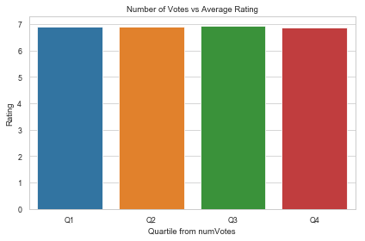
Is movie rating related with number of votes?
To prove this assumption, I use quartile of numVotes to cut all movies’ rating into 4 groups. Within each group, we could calculate a average rating for all movies in inside this group.
From this graph, we can tell that generally 4 group have similar ratings.

Slide 7
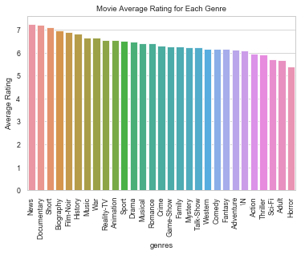
Is movie rating related with movie genre?
For this assumption, group all movies based on “genre” and calculate mean of “averageRating” for each group. Note that a movie might has more than one genre, e.g. drama and adventure. In this case, we will double count it.
Based on this plot, we can see that there are some genres that have higher score than others.

Slide 8
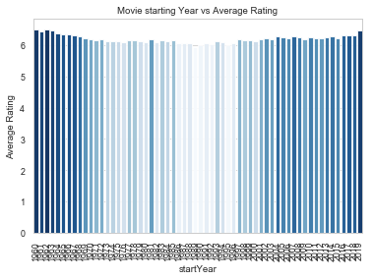
Is movie rating related with year that a movie comes out?
For this assumption, select all movie ratings for a given “startYear”. For visualization purpose, I choose all movies after 1960.
The color of the bar shows the mean rating for that year comparing to others. The darker, the higher rating.
It shows a interesting trend from high to low, and to high again.

Slide 9
Build Machine Learning Model
From the previous EDA part, we have a brief understanding of relation between movie rating and several feature.
Next step: Data Cleaning and feature generation
merging all features and transform categorical feature into dummies
Standardization
Correlation test: remove high absolute correlated pair feature
SVD: generate extra features

Slide 10
ElasticNet Regressor
For this regression/prediction task, I choose using MSE as loss metric.
First model I use is Elastic Net regression. I use a K-fold CV checking MSE for a set of alphas to find the optimal hyperparameter set. And with the best alpha, we run elastic net regression on both training set and test set.
MSE from training set is 1.15993 and MSE from test set is 1.16147

Slide 11
Random Forest Regressor
Second model I use is Random Forest Regressor with a grid search to find the optimal set of hyperparameters.
With the best set of hyperparameter, MSE in training set is 0.97662 and MSE in testing is 0.97671.
It performs slightly better than the Elastic Net Regressor.

Slide 12
Random Forest Regressor
From the random forest feature importance, the top 3 features:
director_score
Documentary
Horror
They are reasonable for the following reason. First, “director_score” represents the average rating of a director's work, which might infer the rating of his other works. Second, “Documentary” and “Horrow”, which is already shown in the plot from EDA section
There are also some trivial relation for other importance features listed in top 10
startYear 6th on the list
numVotes 7th on the list

Slide 13
Conclusion
Random Forest Performs better than ElasticNet, however its computation time is much longer (1 hr (total 80 fits) vs 40 s (total 6 fits) )
The Director past/relevant works’ rating is a strong indicator of movie rating

Slide 14
Future Improvement
Extra Data:
more detailed data with the cast (due to the memory problem, I skip cast data)
Including directors/writers/cast social media data (e.g. number of followers)
total cost for the movie
Other features might affect movie rating
Models Tuning
Consider numVote Weighted rating (feature engineering)

Slide 15
Q&A

Slide 16
Thank you

